Slide 1
Notes and additional resources for users are included in the notes section.
This content is available under a Creative Commons Attribution License. Logos are trademarks or registered trademarks of their respective organizations and may not be reused or reproduced without permission.

Slide 2
Declaration On Research Assessment Improving how research is assessed
sfdora.org
@DORAssessment
Signed by >500 organizations and >12,500 individuals
Supporting organizations
Notes:
DORA is an initiative supported by nine organizations to push for real change in research assessment. The vision of DORA is to advance practical and robust approaches to research assessment globally and across all scholarly disciplines. Individuals and organizations can sign the declaration pledging to improve culture around research evaluation. DORA is collecting best practices to help members of the community learn from each other and create change. More information is on the website: sfdora.org
Journal-based metrics are often misused and ill applied in research and researcher evaluation. This is happens at key transition points during a researcher’s career, including hiring, promotion, and tenure.

Slide 3
Meaningful Assessment Improves Research
Promotes value of all scholarly outputs
Focuses on the merits of the work
Journal articles
Preprints
Datasets
Software
Protocols
Research materials
Well-trained researchers
Societal outcomes and policy changes
Reduces JIF-chasing
Facilitates Open Science practices
Improves rigor and reproducibility
Enhances collaboration

Slide 4
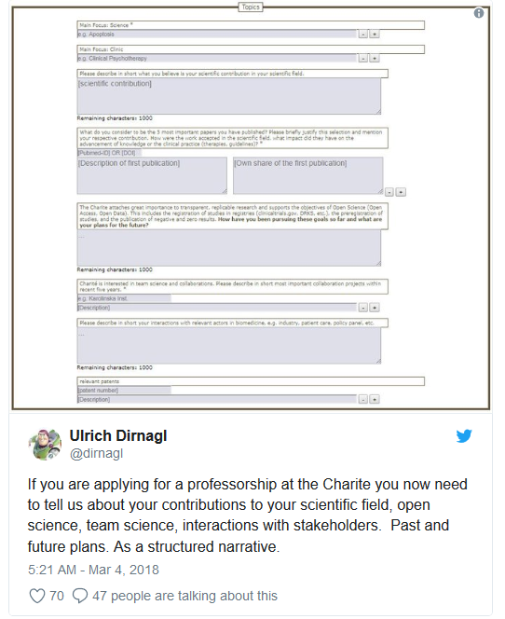
Change is happening: Research Institutes
Application includes:
Contribution to research field
Open Science
Team Science
Interactions with stakeholders
Staff member sits on hiring deliberation meetings as a neutral party to promote balanced discussions
UT Southwestern Medical Center
Dallas, Texas
Candidates receive questions before Skype interviews, so they have time to reflect. The goal is to identify thoughtful individuals, in addition to candidates who process information quickly.
Charité University Hospital
Berlin, Germany
Notes:
UT Southwestern example: https://sfdora.org/2018/05/15/how-to-strengthen-hiring-practices-at-academic-institutions-an-interview-with-dr-sandra-schmid/
Charité University Hospital: https://sfdora.org/2018/07/06/simple-questions-big-insights-charite-uses-bio-sketch-questions-to-recruit-faculty/

Slide 5
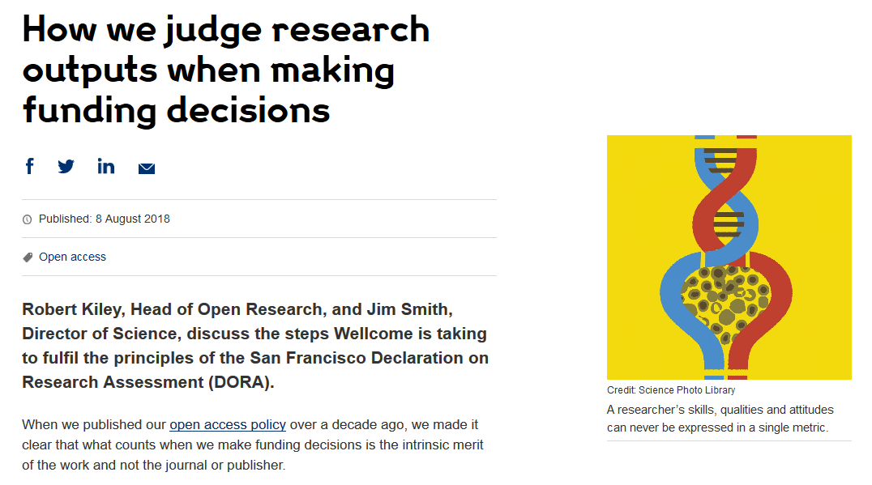
Change is happening: Funders
Cancer Research UK
London, UK
Application includes:
List of research outputs
Summary of 3-5 achievements
Space to describe other measures of impact
Reminds peer reviewers and committee members of DORA principles throughout funding process
Wellcome
London, United Kingdom
Application includes:
List of research outputs
Contributions to mentorship
Output sharing plan to advance potential health benefits
Plans for public engagement
Guidance provided to advisory panel members
Notes:
Wellcome example: https://wellcome.ac.uk/news/how-we-judge-research-outputs-when-making-funding-decisions
Cancer Research UK example: https://www.cancerresearchuk.org/funding-for-researchers/research-features/2018-02-20-improving-research-evaluation-dora

Slide 6
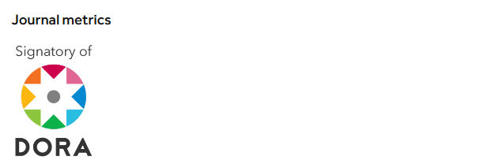
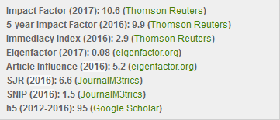
Change is happening: Publishers
PLOS
San Francisco, California
Dedicated page on website describing how its journals comply with DORA recommendations
The Company of Biologists
Cambridge, UK
EMBO Press
Heidelberg, Germany
“Development uses a number of metrics that together provide a rich view of the journal’s performance”
Acknowledges DORA signature
Shows citation distributions for its journals
Presents all available metrics side-by-side and rounded to single digits
Notes:
PLOS example: https://www.plos.org/dora
Company of Biologists example: http://dev.biologists.org/content/about
EMBO examples: http://emboj.embopress.org/about#bibliometrics; http://emboj.embopress.org/content/34/12/1601

Slide 7
What can you do?
Sign DORA
Ask your institution/employer to review assessment practices
Use our collection of good practices to implement change
Tell us about how you improved assessment so we can share your ideas with others

